Slide 1
Domestic Tourism In India
Jeevan Koshy – 1740256

Slide 2
AUTHORS
National Sample survey office National Statistics Organisation Ministry of Statistics & Programme Implementation
NSS 65th round

Slide 3
INTRODUCTION (rural + urban)
July 2008 – June 2009
Number of trips made in year – Rural, Urban
Characteristics of trips
Type of stay
Mode of travelling
Gender profile
Purpose for travelling
Expenditure for trips

Slide 4
SCOPE (rural + urban)
Items of enquiry
Geographical coverage
Discusses different aspects of tourism
Definitions
Average number of trips – overnight, same day
Time taken – travel, duration etc.
Industry variation
Type of stay – friends, relatives, hotel

Slide 5
HOUSEHOLD (rural + urban)
Occurrence among households
Household occupation/profession
Caste, religion
Economic level
Impact of visit of NRI’s

Slide 6
EXPENDITURE (rural + urban)
Per overnight trip, per day trip
Leading purpose behind trip
Break – up of expenditure in trip
State wise division of expenditure between rural & urban

Slide 7
DETAILED TABLES (rural + urban)
Number of households(Per 1000) –
Surveyed
Reporting overnight, day visitors
Each religion
Awareness of ‘Incredible India’ campaign
Average expenditure per trip
Average number of places visited
Average duration of trip

Slide 8
OUTLINE
Subjects covered
Geographical coverage – UT, States (except a few)
Participation of states
4 sub – rounds of 3 month duration
Enquiry on -
List of households
Domestic tourism
Housing condition

Slide 9
SAMPLE DESIGN
Stratified multi – stage design
List of 2001 census villages consisted of sampling frame.
Stratum divided based on population of town (50,000)
Total sample size – 13996 First stage units at state level
Sample size allocated according to population
FSU’s shouldn’t exceed the population
Second stage stratification - SRSWOR

Slide 10
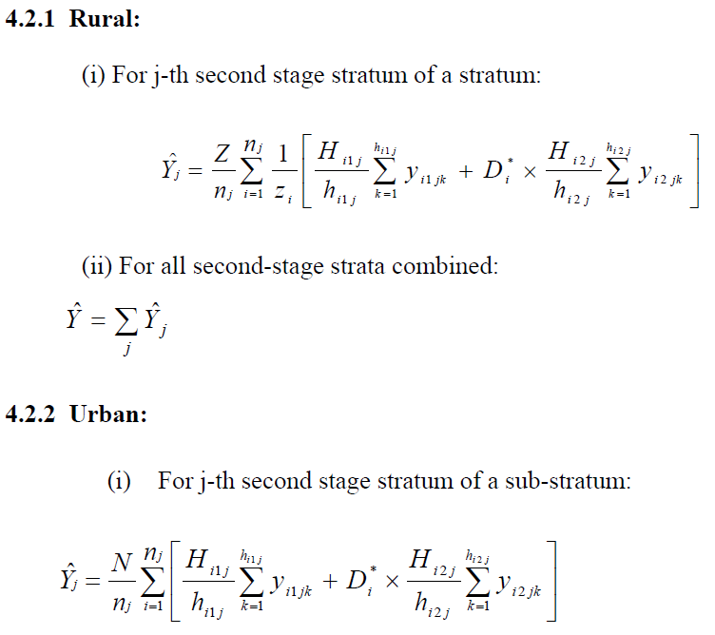
ESTIMATION

Slide 11
NOTATIONS
Y = Population total
Z = total size of rural stratum
z = size of sample village
H = total number of households
h = number of households surveyed in stratum
y = observed value of characteristics under estimation
D = total number of sub – block’s formed in the sample
d = subscript for sub - block

Slide 12
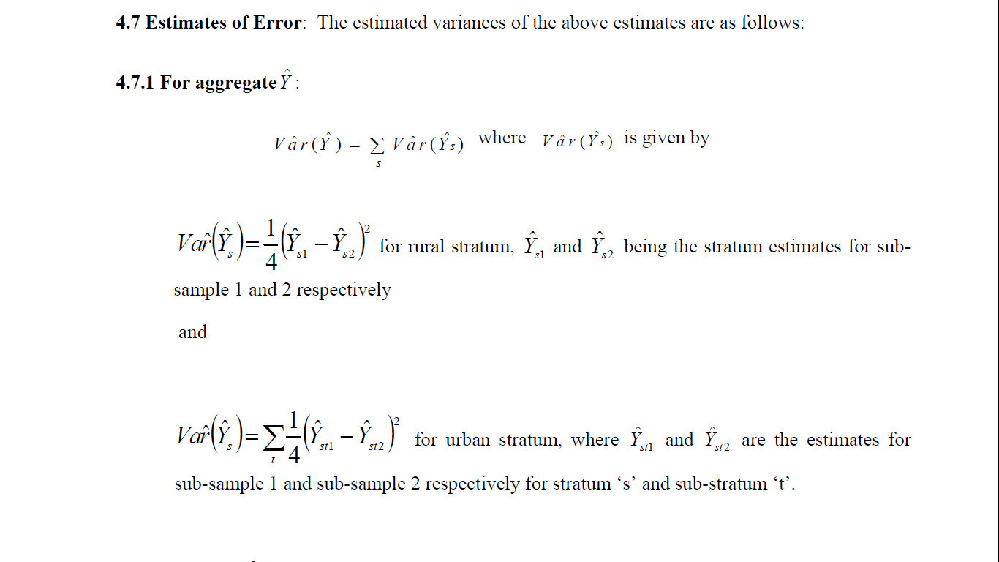
ERROR

Slide 13
☹……………☺ THANK YOU!

